Slide 1


Steam Store
“get dat money”

Slide 2
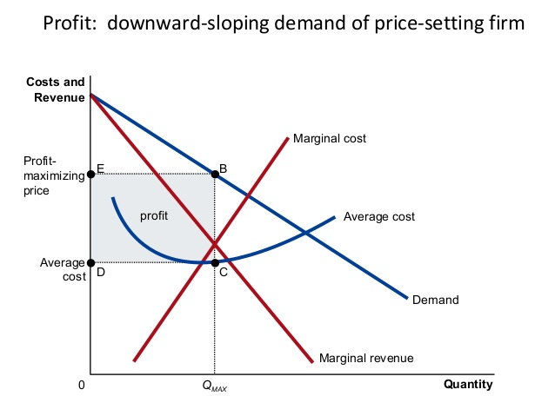
Traditional profit maximization
Marginal Cost = Marginal Revenue

Slide 3
But what about when marginal cost doesn’t increase?
Digital goods have high development cost, but negligible variable costs
Commonly seen strategies:
Low pricing per unit
freemium pricing
Bundling
Step down pricing

Slide 4
The Steam Store
What is Steam?
The “app store” for PC games
67 million monthly active players.
Steam is averaging 14 million concurrent users per day
Valve reported 125 million total active lifetime users last year. (april 2016)

Slide 5
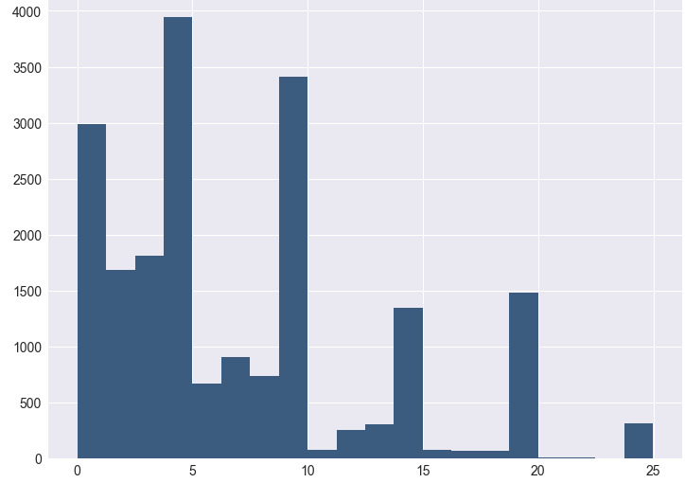
Price vs total products under $25

Slide 6
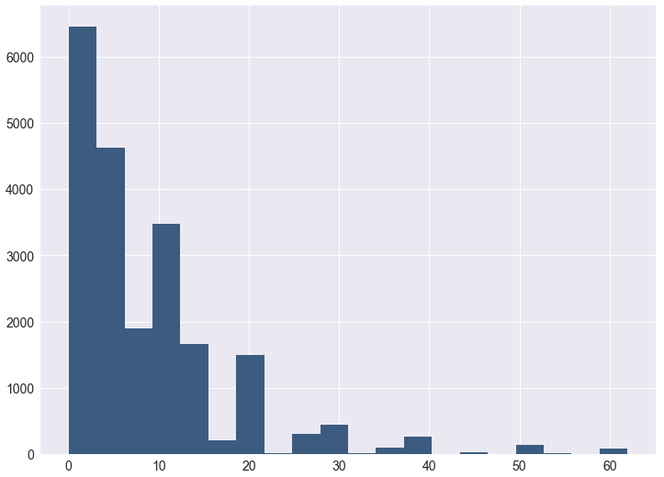
Price vs total products under $60

Slide 7
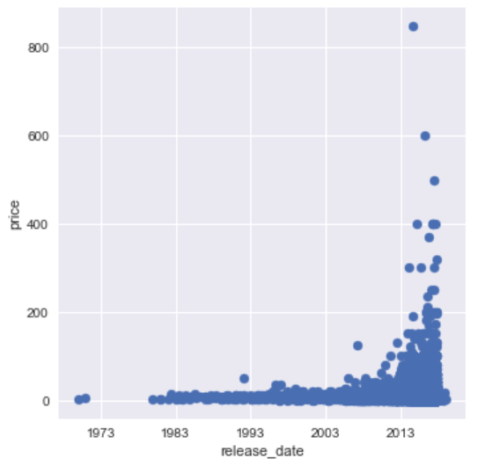
Price vs. Release Date (step down pricing)

Slide 8
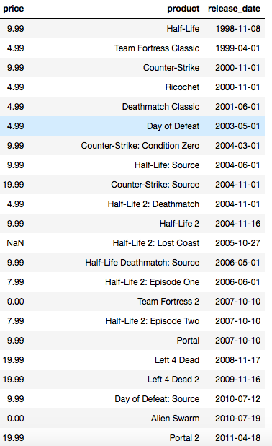
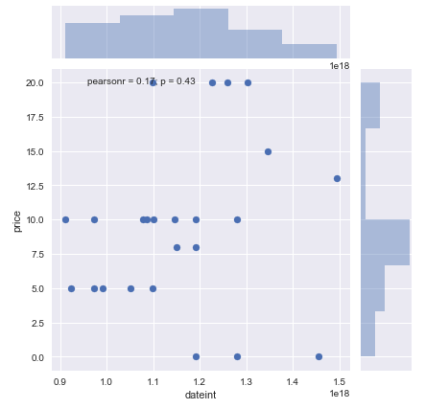

Valve
Notes:
Team Fortress 2, Alien Swarm and SteamVR Performance Test are the $0 ones
BUT Team Fortress 2 and Alien Swarm aren’t bad games- both scored positive and overwhemingly positive reviews from players- but they’re multiplayer shooters .
They need a lot of players on the game simultaneously in order to be enjoyed

Slide 9
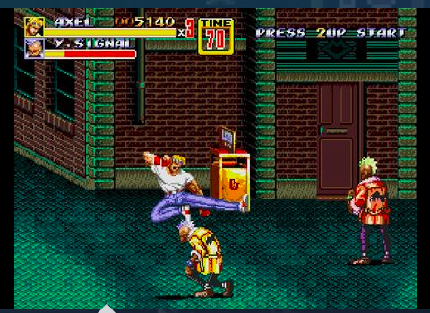
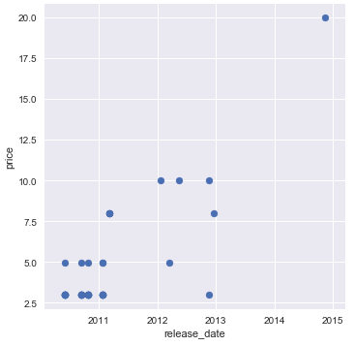
SEGA “We sell nostalgia!”
Notes:
Streets of rage 2. high point? Valkyria Chronicles- a new(ish) game

Slide 10
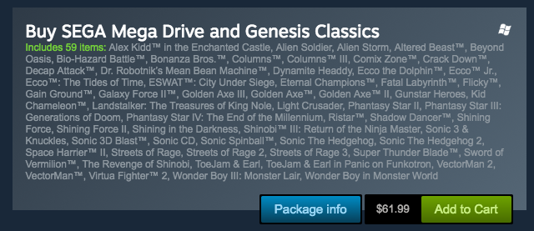
Sega ”We sell in bundles too!”

Slide 11
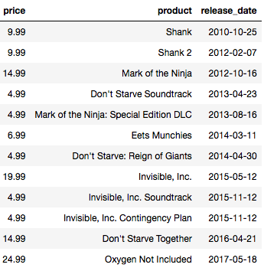
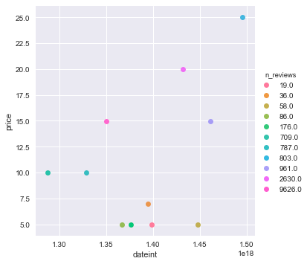
Klei Entertainment

Slide 12
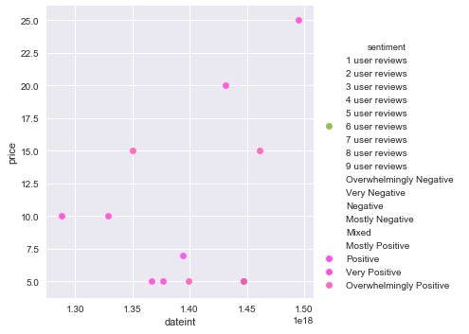


Telltale Games
Notes:
Cheaper ones- lower development cost- poker night at the inventory, puzzle agent, poker night 2 and telltale texas hold’em.

Slide 13
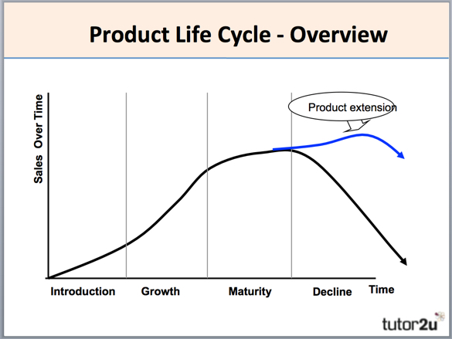
So why reduce price? Why bundle?

Slide 14
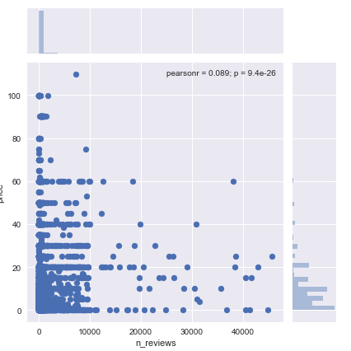
Further Exploration: Reviews vs. Price

Slide 15
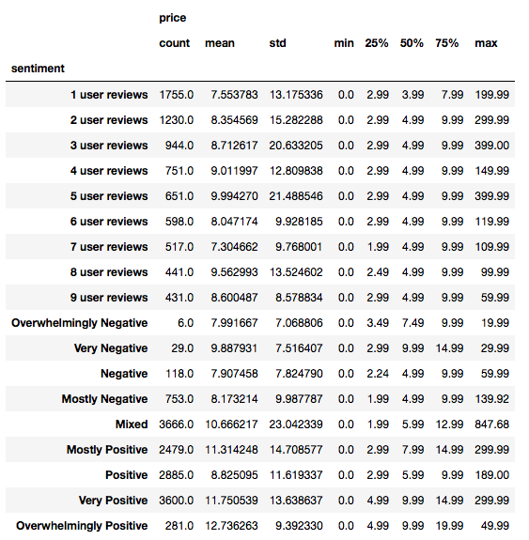
Reviews vs Price continued

Slide 16
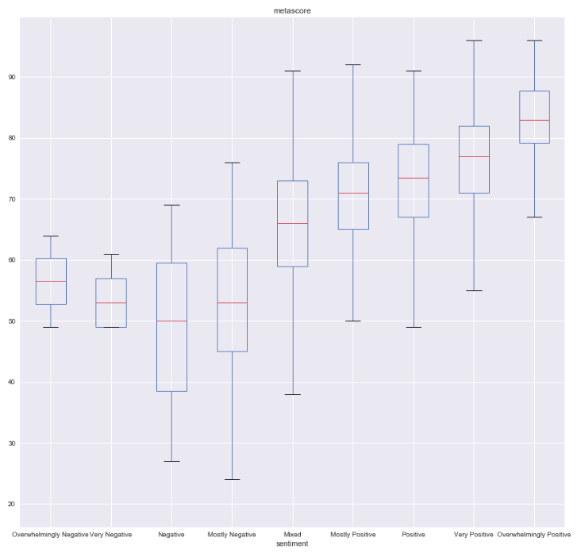
Critical Reviews vs Player Reviews

Slide 17
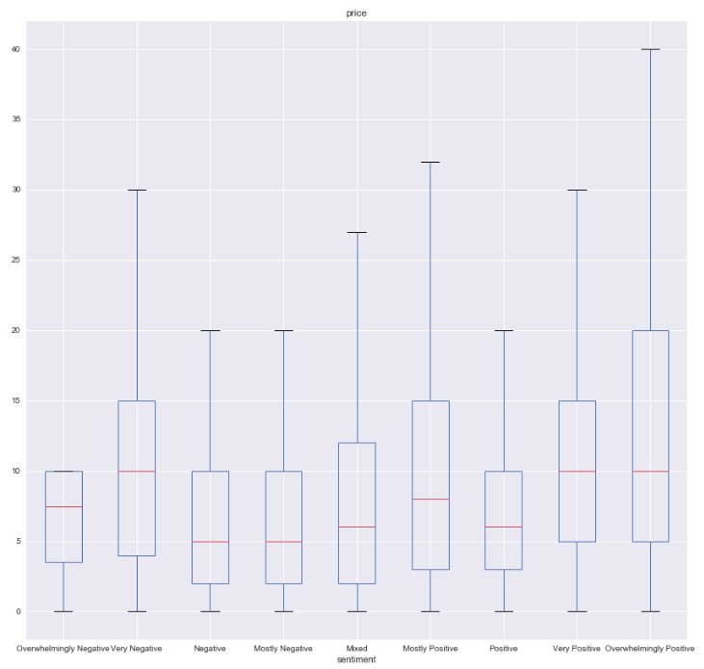
Player Reviews vs Price

